Slide 1
Ethical Approval
CO6008
Week 11
Ralph Ferneyhough

Slide 2
Getting ethical approval
What is research ethics?
Why do I need to get ethical approval?
How (& when) do I get ethical approval?
The ethics application process in detail
Dos and don’ts

Slide 3
What is research ethics?
Ethics is a branch of philosophy concerned with behaviour
Specifically with what behaviour is right, good, or correct, and what is wrong, bad, or prohibited
Ethics can be understood as the task of answering "What should I do?" which is never a simple matter
Research is systematic investigation with the aim of establishing facts and reaching new conclusions

Slide 4
What is research ethics?
Therefore, Research Ethics is about establishing what is the right, good, or correct way of doing research and innovation
and also defining wrong, bad or prohibited ways of carrying out your project tasks
Debate about the ethics of medical or biological research sometimes makes the headlines
e.g. research using animals or stem cells; cloning; genetically modified crops
Research and development in other subjects – including computing – also has to be done ethically
even where human or animal subjects are not involved
Ethical approval is also required outside of academia
Getting approval in this way is good practice for life after university!

Slide 5
Why do I need to get ethical approval?
From the university’s Research Governance Handbook:
“The public is entitled, and the University is committed, to high scientific, ethical and financial standards, transparent decision-making processes, clear allocation of responsibilities and robust monitoring arrangements in the governance and conduct of research.
Proper governance of research is therefore necessary to ensure that the public and funding bodies can have confidence in and benefit from research, by seeking to:
protect the safety, dignity, rights and well-being of research participants;
promote useful, ethical, valid, safe and affordable research;
prevent futile, unethical, invalid, dangerous and extravagant research.”

Slide 6
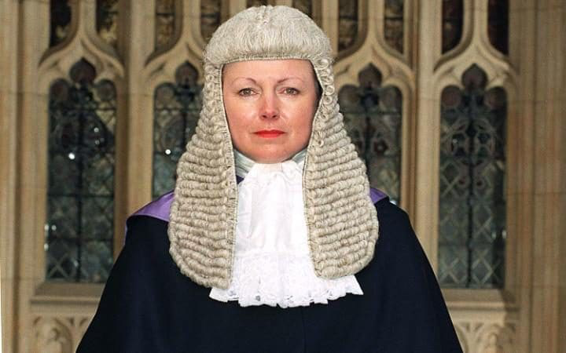
Why do I need to get ethical approval?
“Guiding Principles” of ethical research:
“Research should be undertaken in accordance with commonly agreed standards of good practice, such as those laid down in the Declaration of Helsinki for the conduct of clinical research. These fundamental and widely accepted principles may broadly be categorised as:
Beneficence – ‘do positive good’
Non-malfeasance – ‘do no harm’
Informed Consent
Confidentiality/Anonymity”

Slide 7
Computer Ethics
The moral principles that regulate the use of computers
Four things to consider:
Computer crime
Stealing funds, stealing data, hacking, …
Responsibility for computer failure
Protection of computer property, records, and software
Intellectual property rights, copyright, software piracy, plagiarism, …
Privacy of the company, workers, and customers
Identity theft, spamming, …

Slide 8
Ten Commandments of Computer Ethics
http://www.computerethicsinstitute.org/images/TheTenCommandmentsOfComputerEthics.pdf

Slide 9
Think about ethical issues…
Professionalism
Lack of professional skills can cause projects to fail
Lack of ethical standards can have knock on effects
e.g. lead to unemployment
Plagiarism
Code and algorithms can be considered intellectual property, and using code or algorithms developed by others without giving credit pushes the boundaries of IP law and ethics

Slide 10
Think about ethical issues…
Privacy
To what extent do we have a right to privacy?
IT departments may sometimes be called upon to monitor employees' internet activity.
Often a trade-off between security and privacy
e.g. should the government have access to data so they can analyse it for security threats?
Data Collection
Many companies use digital consumer data to help make decisions
It is paramount that this data be collected in an ethical manner
Always ask for consent for data collection within digital consumer material and websites

Slide 11
Think about ethical issues…
Inclusivity
To what extent does computing marginalize others?
Technology can negatively affect people who can’t readily adapt
e.g. elderly, disabled, in poverty, …
Algorithmic bias
Many laypeople make the incorrect assumption that technology is value-neutral
But algorithmic bias is an example of how technology can perpetuate human prejudice and inaccurate data.
Algorithms are only as smart as the data we train them on
If an algorithm is based on a dataset created with a racial, gender, or socioeconomic bias, its output will perpetuate the systemic bias shown in datasets used to train it

Slide 12
Think about environmental issues…
Physical and Mental Health
How may it be improved?
e.g. using wearable technologies
Impact on Climate
Most computers are inefficient in power consumption
Can you minimize this?
Lots of finite resources used in trace amounts (gold, copper, lithium, …) and hard to recycle

Slide 13
Think about cultural issues…
Social Media is changing interactions
Used to hold businesses/politicians accountable
Influence opinions
But also to spread abuse!
Employment
Impact on lower skills workers?
Globalism
Do individual cultures get displaced?
e.g. we always programme in the English language

Slide 14
Think about legal issues…
Cyber Security
It is illegal to make unauthorized access to computer material
To commit further crimes such as blackmail
To impair a computer’s operation
Hackers can pose a serious threat to companies, financial institutions, government agencies, NHS, …
Intellectual Property (IP)
Patents, copyright and trademarks
Use of software licenses
Software is generally protected by copyright, unless it is in the public domain
but you still have to agree to a license for free software
Will your software be proprietary (source code not available) or open source?

Slide 15
Ethical Hacking?
The cybersecurity practice of testing digital security systems for vulnerabilities to find out how to fortify them better against hackers
Some would even argue that illegal hacking can be used ethically to expose corporate or government corruption
E.g. such as in the case of the Panama Papers that were published to WikiLeaks starting in 2016

Slide 16
How (& when) do I get ethical approval?
You will use an online approval process:
https://ugethics.chester.network
You will need to work with your supervisor to complete your application
You will have to get their agreement before submitting the form
The final submission deadline is 18th January 2024
The department’s Ethics Officer will then check your application
If anything important is missing, your application will be sent back to you, unapproved, for corrections
There may also be other questions about your proposed research. You’ll need to answer these as well before your form is finally approved
Ethical approval is not optional – you must get final approval for your application before you submit your dissertation.
The online system will keep track of who has, & hasn’t, got final ethical approval
Not getting final ethical approval will cause you to lose 5 marks off your Dissertation mark

Slide 17
The ethics application in detail
The application system will ask you for
information about:
Working title
Aims and objectives of dissertation
e.g. purpose of study, specific hypotheses
Methodology
procedure for solving the problem
Participants
sample size, age group, procedure for recruitment
Procedure for seeking participants’ informed consent
Are there any issues of possible, harm, discomfort, or distress might be suffered by participants?
(If yes, how will these be dealt with?)
Legal issues
Social issues
The system will suggest ideas for many of these categories
It won’t let you leave sections blank
You must agree to abide by the BCS Code of Good Practice

Slide 18
Testing - Using Questionnaires
If you use people to test your artefact then typically you will use a questionnaire
On your ethics form you must cover all aspects of doing so, especially data protection
If you have any people outside of England completing a questionnaire, the University requires you to add the following reference to the Singapore Statement:
“This research study complies with current legislative requirements for England and with the commonly agreed international standards for good practice in research. These are laid down in the Singapore Statement on Research Integrity and are categorised as: Honesty in all aspects of Research; Accountability in the conduct of research; Professional courtesy and fairness in working with others and Good stewardship of research on behalf of others. The University of Chester recognises that there may be ethical and cultural differences across jurisdictions. Participants are therefore advised to be aware of any local requirements and to exercise care in their decision to take part.”

Slide 19
BCS Code of Good Practice
Provides guidelines on how to:
Maintain your technical competence
Adhere to regulations
Act professionally
Use appropriate methods and tools
Participate maturely
Respect the interests of your users
Promote good practices
A pdf copy of the guide can be downloaded from the Moodle Web Site

Slide 20
Do:
Fill in all sections of the online form accurately, and submit your application on time
Get final approval before starting experimental work (e.g. questionnaires or user testing)
Do what you said you would do (e.g. recruiting subjects from a specific age group, providing an information sheet, or maintaining confidentiality)
Include a copy of your approved application in your dissertation, as an appendix
Write about the research ethics of your project in your dissertation
Cover every area of ethics – even if you have no perceived issues, say so explicitly
Don’t:
Be late submitting your application
Ignore what you said in your ethics form when actually doing your project
Forget to include a copy of your approved application in your dissertation
Fail to mention ethics in the main body of your dissertation
Fail to get final approval for your application
Agreement from your supervisor, on its own, isn’t enough

Slide 21
Benefits of the process
Use it to your advantage
Clarify your aims and objectives
Avoid doing useless work/research
Avoid awkward questions at your project presentations, and / or poor marks due to incorrect methodology or poor project planning
…and the faster you get it done (properly), the sooner you can get onto the interesting stuff…

Slide 22
Remember…
Failure to obtain ethical approval will result in a penalty of 5 marks being applied to your dissertation mark
Discuss ethics for your project at the next meeting with your dissertation supervisor
On submission, the form will go via your supervisor first to approve – work with them to get the final submission approved smoothly
https://ugethics.chester.network/

Slide 23
Finally
Deadline for draft of Chapters 1 and 2 of your report:
5:30pm on Thursday 14th December 2023
Delivered directly (usually via email) to your supervisor
Feedback may take a short while due to holidays
Deadline for final ethics submission:
5:30pm on Thursday 18th January 2024
You should submit first versions earlier than this to allow your supervisor to give feedback and for you to make corrections

